Slide 1




Red Limpia
Phase-3
New OF Laying in Dhaka City
Summit Communications Limited

Slide 2

Red Limpia Phase-3 Working Steps
1
Specification & Vendor
Project Charter merged with main project.
Fiber Selection
2
New Fiber Laying Design in Dhaka City: Express or Replica
Design
3
DUCT, HH Find Out, POC
Readiness
4
Vendor Selection, HDD, Permission
Execution

Slide 3
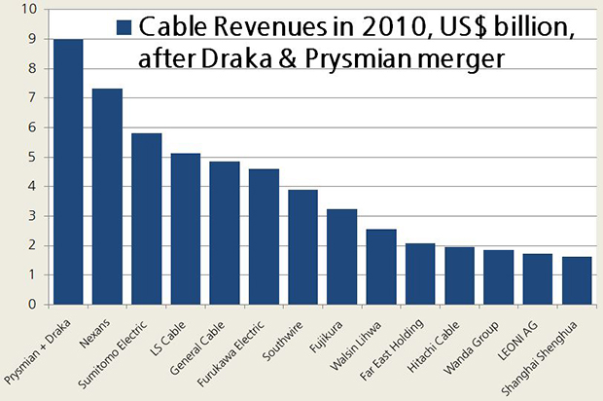

OF Vendor Selection
Red Limpia
Source: www.integer-research.com

Slide 4
List of OF Vendor
Red Limpia
List-1
Prysmian (UK)
YOFC (China)
Birla (India)
List-2
OFS (USA)
Nexans (UK)
Sumitomo Electric (USA)
Corning (USA)
Fujikura (JP)
LS Cable (South Korea)
General Cable (USA)
Furukawa Electric (JP)
Communication with OF Vendor
YOFC
-Placed our expectation
- Field Visit with Chinese expert (WASA POC).
- YOFC agree to meet us requirements.
Prysmian
- SCM collected the technical specification from them.
Fujikura
- Requirements placed to local representative.

Slide 5
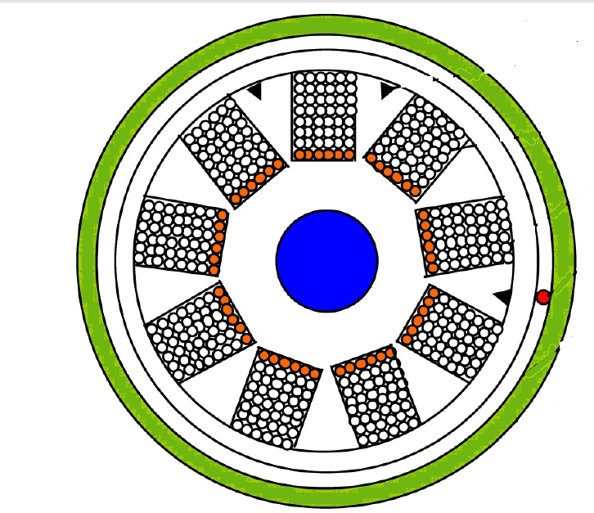
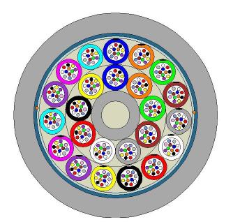
OF Specification & Design
Red Limpia
Existing Type
Proposed Type
Ribbon Fiber
Loose Tube

Slide 6
OF Specification & Design
Red Limpia
Express Core Features:
• Patched with minimum number of POCs between starting and ending location/zone.
• Fewer number of splicing points, which minimizes high loss issues.
• Minimize frequent outages due to maintenance or implantation works by field teams.
• Ensures quality for backbone and high priority clients/links.
OR
Replica Network Features:
•Patched with all POCs between starting and ending location/zone.
•Higher number of splicing points, which increases high loss issues.
•Frequent outages due to maintenance or implantation works by field teams.
•Should be used for area wise connectivity, access links etc.

Slide 7
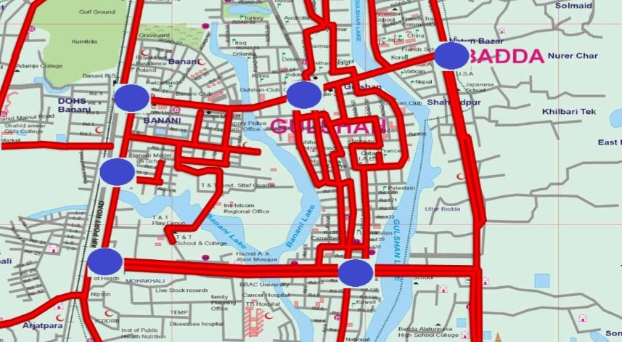
New OF Distribution Design
Red Limpia

Slide 8
Thank You
Notes:
You can safely remove this slide. This slide design was provided by SlideModel.com – You can download more templates, shapes and elements for PowerPoint from http://slidemodel.com

